Slide 1
GEHC SDT Weekly Status Report
04/06/17

Slide 2
Open Actions
Action item | Owner | Forum | Expected Closure Date | Actual Closure Date | Owner Comment | Status
Mobility Team or tiger team to be formed to resolve all CLICK mobile issues. | Rohit/Gopi | Jan’ 17 Workout | TBD |  | On monitoring the debug logs: Meera confirmed that no mobile sync issues apart from FE(Kim Tae Hyun) | In Progress
Performance issues: SDT Booking and Architecture Assessment. | Hita/Andrey/Urmila/Chandra | Jan’ 17 Workout | 28-Feb-2017 |  | Demo presented to Product Owners : SDT booking load time reduced by 45- 50% on CRP. | In Progress
Ownership on Tickets/Process adherence(Agile Mechanism) | Suvarna/Sathyaraj | Jan’ 17 Workout | Ongoing |  |  | In Progress
GEHC to check and confirm on L1 support - on call support | Chandra/CG | Jan’ 17 Workout | TBD |  | No services available in ServiceNow tool. Exploring other opportunities | In Progress
CLICK DB access for CG team GE to setup a separate call to discuss | Chandra/CG | WSR meeting | TBD | 06/04/2017 | DB backup received, and imported the DB backup to our local server. | Closed

Slide 3
Weekly Snapshot – 04/06/17
Health of the Engagement
Highlights
CLICK : R2.3 deployment completed on SB3 for 9 EU and 6 ASEAN templates
Weekly Master data uploaded successfully
Implemented the SDT booking performance in CRP demoed to product Owner
End to End testing of all business scenarios to capture the Performance Timings
GREEN
Risk / Issues / Challenges
Help Needed
Issues in comprehending data flow due to unavailability of CLICK environment details - Rohit
Need resolution to timing / frequency of backup, patches and domain policies - Chandra

Slide 4
Focus Area Updates
Focus Areas | Owner | Status | Comments
Mobile Sync Issues | CG Team | In Progress | Yet to receive end to end environments details from CLICK team denied due to policy reasons Connected with business user for issues reported in debug log) - Korea FE(Kim Tae Hyun) has a sync issue – Sync after 21 hours Investigation in progress
SDT Booking Performance Issues | CG Team | In Progress | US183-Analysis on feasibility report for removing the Bump functionality due to non-usage in GEHC SDT and Impact Completed SPRINT Demo for performance user stories 45- 50% on CRP
Release Management | CG Team | Ongoing | Release check list was created and it is updated in our Release readiness check call.
Incident Management | CG Team | Ongoing | Streamlining incidents w.r.t CLICK support cases Problem ticket creation process finalized. Incidents reported in this week are closed.
Support and Development Process streamlining | CG Team | Ongoing | Agile metrics identified and tracked through Rally. Ensuring all email communication to have incident ticket created. Internal defect tracker is maintained to track the QA/UAT defects and owners defined for each defect.

Slide 5

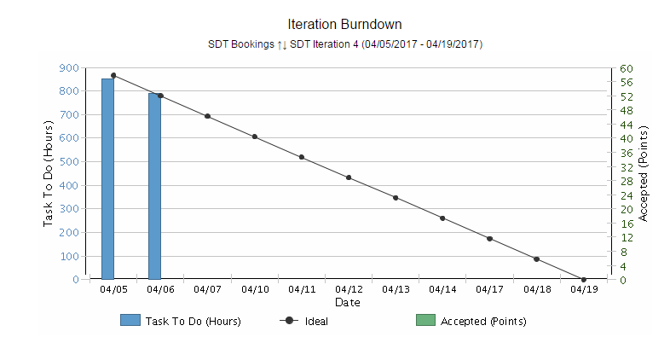
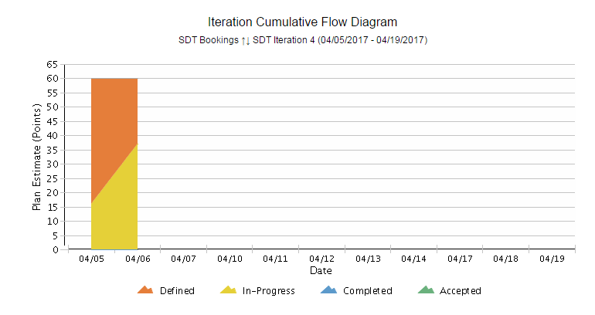
Agile Metrics - Development
Iteration Burndown Chart:
Committed for 60 Story points
During Sprint planning 1st part defined the goal of the sprint for performance user stories prioritized by product owner.
Sprint Planning 2nd part Created Sprint backlog with Task creation and estimation. All User Stories are added on day 1.
Day 2 started working on some of the user stories.
Iteration Cumulative Flow Diagram
First day of the Sprint 12 user stories added in the sprint backlog.
Team started working on some of the tasks from 6 user stories which shows the tasks are in progress.
SDT Iteration 4 (04/05/2017 -04/19/2017)
Inferences
Inferences

Slide 6
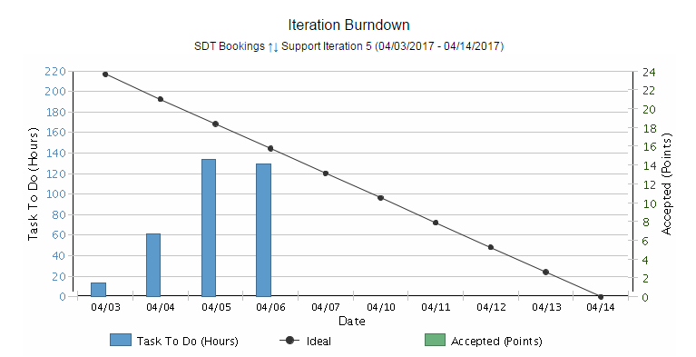
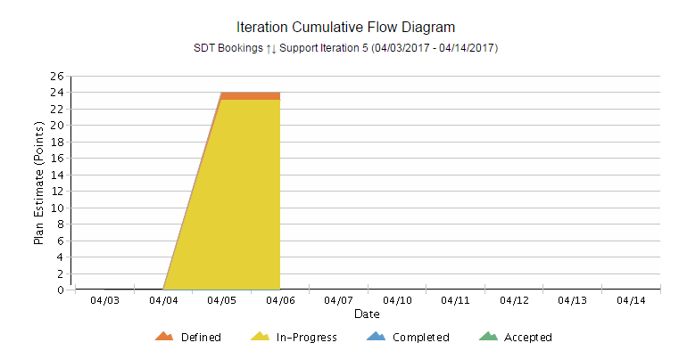
Agile Metrics - Support
SDT Click, Support and Incidents
Support Iteration 5 (04/03/2017 - 04/14/2017)
Inferences
Iteration Support Burndown Chart:
Support activities keep on added up on a daily basis based on the support tickets that we receive. Hence there’s a mismatch with ideal.
End of the sprint, all tickets are closed and all the user stories are accepted by Product owner.
Iteration Cumulative Flow Diagram
The tasks related to Release 2.3 and ES LS popup issue, Mobile Sync issues and 1 Incident are in Progress.
3 Incidents are completed.
3 tickets are in defined state.

Slide 7
Agile Metrics – SDT Booking Velocity Chart
SDT
Inferences
Velocity Chart
SDT Iteration 1
Velocity of team:50 story points
Accepted By PO: 13 story Points
US85 and US 97 –Accepted by PO as these user stories are already deployed in production as part of release 1.3.1
Iteration length: 10 days(2 weeks)
SDT Iteration 2
Velocity of team: 9 story points
Accepted By PO: 9 story Points
Iteration length: 5 days(1 week)
SDT Iteration 3
Velocity of team: 20 story points
Accepted By PO: 17 story Points
Iteration length: 8 days

Slide 8
Agile Metrics – Support Velocity Chart
Inferences
Support
Velocity Chart
Support Iteration 1
Velocity of team:5 story points
Accepted By PO: 5 story Points
Iteration length: 8 days
Support Iteration 2
Velocity of team:20 story points
Accepted By PO: 19 story Points
Iteration length: 12 days
Support Iteration 3
Velocity of team:20 story points
Accepted By PO: 20 story Points
Iteration length: 11 days
Support Iteration 4
Velocity of team:17 story points
Accepted By PO: 17 story Points
Iteration length: 11 days

Slide 9
Agile Metrics – Resource Utilization
Weekly resource Utilization(5th Apr 2017 – 19th Apr 2017)

Slide 10
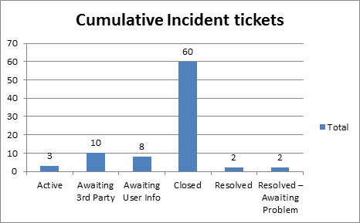
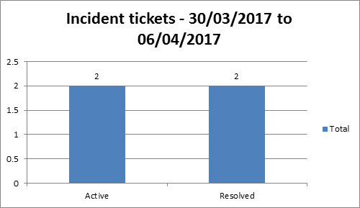
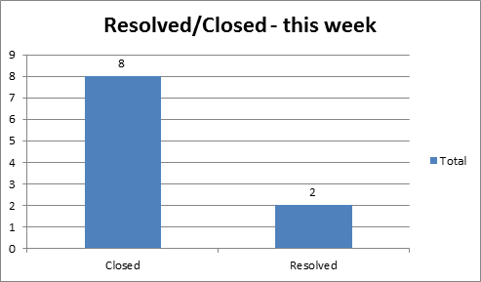
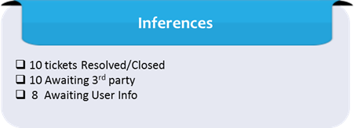
Incidents Update
Inferences

Slide 11
Incident Tickets
Incident Management
Incident # | Module | Key Words | Priority | Status | Location | Queue wait time
INC1735928 | SDT Schedule | Click Issue | 4 - Low | Awaiting 3rd Party | ASPAC-South Korea-Seoul | a month ago
INC1736222 | SDT Schedule | Click Issue | 4 - Low | Awaiting 3rd Party | ASPAC-India-Bangalore | a month ago
INC1738700 | SDT Module | Click Issue | 3 - Moderate | Awaiting 3rd Party | ASPAC-India-Bangalore | a month ago
INC1747182 | SDT Mobile | Click Issue | 3 - Moderate | Awaiting 3rd Party | ASPAC-India-Bangalore | 30 days ago
INC1754593 | SDT Module | Click Issue | 5 - Request for Service | Awaiting 3rd Party | ASPAC-India-Bangalore | 28 days ago
INC1766606 | SDT Module | Mobile Sync Issue | 3 - Moderate | Awaiting 3rd Party | ASPAC-India-Bangalore | 21 days ago
INC1777886 | SDT Module | Click Issue | 3 - Moderate | Awaiting 3rd Party | EMEA-Israel-Haifa | 17 days ago
INC1778499 | SDT Module | Click Issue | 3 - Moderate | Awaiting 3rd Party | ASPAC-Malaysia-Wilayah Persekutuan | 17 days ago
INC1779626 | SDT Module | Click Issue | 3 - Moderate | Awaiting 3rd Party | ASPAC-Malaysia-Wilayah Persekutuan | 16 days ago
INC1793968 | Click | Click Issue | 5 - Request for Service | Awaiting 3rd Party | ASPAC-Malaysia-Wilayah Persekutuan | 11 days ago
INC1464027 | SDT Booking | Click Issue | 1 - Critical | Awaiting User Info | ASPAC-Malaysia-Wilayah Persekutuan | 2 month ago
INC1477114 | SDT Booking | Mobile Sync Issue | 4 - Low | Awaiting User Info | ASPAC-South Korea-Seoul | 1 months ago
INC1480772 | SDT Mobile | Mobile sync Issue | 4 - Low | Awaiting User Info | ASPAC-South Korea-Seoul | 1 months ago
INC1781463 | SDT Module | SDT Booking issue | 4 - Low | Awaiting User Info | ASPAC-South Korea-Seoul | 16 days ago
INC1782655 | Click | Click Issue | 3 - Moderate | Awaiting User Info | ASPAC-Malaysia-Wilayah Persekutuan | 15 days ago
INC1787373 | Click | Click Issue | 3 - Moderate | Awaiting User Info | ASPAC-Malaysia-Wilayah Persekutuan | 14 days ago
INC1787399 | Click | Click Issue | 1 - Critical | Awaiting User Info | ASPAC-Malaysia-Wilayah Persekutuan | 14 days ago
INC1787868 | SDT Module | SDT Booking issue | 3 - Moderate | Awaiting User Info | ASPAC-Malaysia-Wilayah Persekutuan | 13 days ago
Problem Management
Problem # | Module | Keyword | Status |  |  | Incident #
PRB0045855 | SDT Booking | Google API | Open |  |  | INC1371682, INC1389372, INC1357120
PRB0045475 | SDT Booking | Performance - Connectivity | Known Error / Pending CA |  |  | INC1310582

Slide 12
THANK YOU

